Slide 1


Understanding
Pre-sales

Slide 2
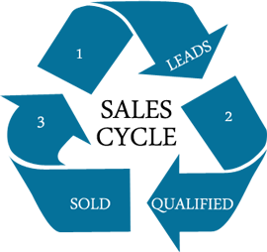
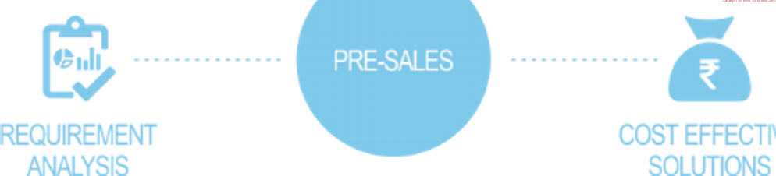


What we’ll be learning
Solution Design

Slide 3
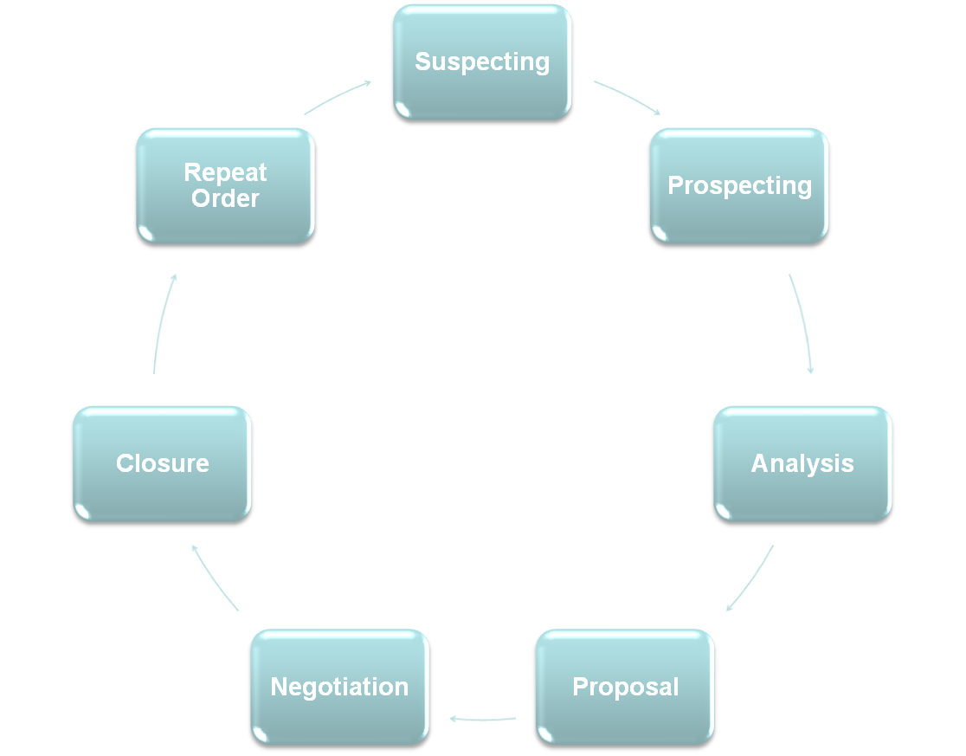
SALES CYCLE

Slide 4
Sales Cycle
Suspecting
Identifying the sales lead
  Trade Fairs, Industry Forums
  Online Marketing, Social Media
  Market research
  Inside Sales Team
Prospecting
Qualifying the sales lead
For a sales lead to qualify as a sales prospect, qualification must be performed and evaluated –
  Product Applicability / Fitment of Solution
  Ability to afford our solution
  Time frame of purchase

Slide 5
Sales Cycle
Analysis
Taking the qualified prospect through a question and answer session to identify the requirements
Help the buyer identify and quantify a business need or a ‘gap’ between where prospect is today and where it want to be in future
Proposals
Come up with a business proposal suggesting various products/services that will suffice the need of the prospect
Includes Cost, Schedule and other information
Negotiation
Negotiate the terms set in the business proposal
Pricing (Technique & Amount)
Scope of the Project
Timeline

Slide 6
Sales Cycle
Closure
Making the actual sale
Getting the Sign-off / purchase order
Getting the contract/ SOW signed
Repeat Orders
Maintaining the relationship with client and brining more orders through
Cross Selling, Other Project Opportunities
Order Renewals

Slide 7
WHAT IS PRE-SALES
Pre Sales includes the:
entire gamut of activities involved in preparing to engage with prospects / clients
specific responses to client requests

Slide 8
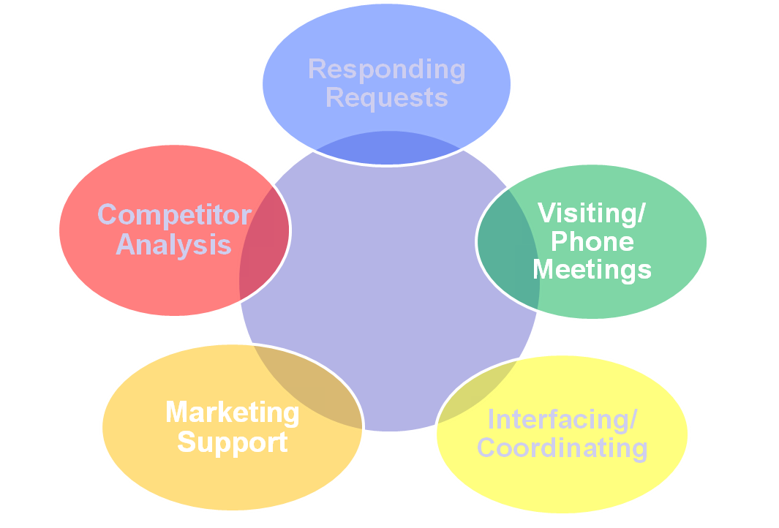
Pre-sales

Slide 9
Pre-sales
Responding to client requests:
Responding to RFP, RFI, RFQ
Providing any information to the client, which helps him take the buying decision
General client queries about solutions and capabilities
Visiting/ Phone Meetings:
Visiting client for meetings
Scheduling online meetings
Due diligence – to get a clear understanding of the requirement
Demonstration of Proof-Of-Concepts or product
Solution presentation to the Client

Slide 10
Pre-sales
Interfacing & Coordinating:
Need to interface & coordinate with-
  Technical Competency Deptt.
  Functional SME/ project incharge
  Legal and Financial
  Delivery Teams
  Recruitment
  External dependencies/ Third party Tools & Software

Slide 11
Pre-sales
Marketing Support:
For various marketing events, need to support marketing team through
Offering and Capability related documents, case studies, brochures
Competitor Analysis:
Clients receive response from multiple vendors, so one must know where does it stand against competition
What is our competition in an industry / for a specific bid opportunity and what are their offerings / differentiators
Market scanning is done through market research reports, analyst reports

Slide 12
Understanding RFx
RFI/ EOI
Request for Information / Expression of Interest
These are usually relatively short documents that ask specific questions about the vendor and services vendor provides
Capability Evaluation
Often used as pre-qualifier to determine which vendors will receive an RFP or RFQ – Vendor Empanelment

Slide 13
RFx
RFP
Request for Proposal
These are often lengthy documents that provide detailed information on requirements:
  functions & workflow,
  business goals,
  integration specs, etc
to the vendors so they may propose a solution which meets the Client’s needs and goals
It often includes scope of requirements, pricing requirements, contract terms & conditions, as well as detailed case studies & reference requirements

Slide 14
RFx
RFQ
Request for Quotes
Can be part of an RFP or RFI
This is a request for pricing based on what's outlined in the RFI or specified in an RFP, or can be used as a request for ala carte pricing for various service options

Slide 15
RFI , RFP & RFQ
A company can do any one or more of the above, usually in the order shown
Often the RFP may incorporate both the RFI and RFQ as sections of the doc, and also include other evaluation steps such as a demo, proof-of-concept or presentation
A big advantage of using RFI, RFP or RFQ in software evaluation is that it allows vendors to self-eliminate because they can better assess their own chances
This helps the buyer narrow down the choices to the most feasible solutions

Slide 16
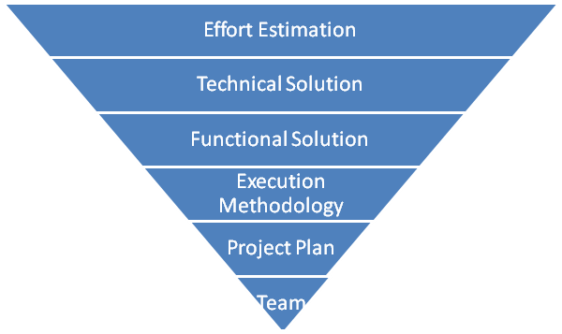
Solution Design

Slide 17
Solution Design
Effort Estimation
Estimating how much effort it is going to take to complete the project
Various industry standard methodologies are used for effort estimation like functional point (FP), work breakdown structure (WBS), simple-medium-complex (SMC)
Given in Person Months

Slide 18
Solution Design
Technical Solution
Technical Solution, addressing the client’s requirements
Technology Selection
Technical Architecture
Technology Stack
Licensing / Sizing Information
Infrastructure / Hosting Solution
Compliance to NFR (non-functional requirement)

Slide 19
Solution Design
Functional Solution
Functional Solution, addressing the client’s requirements
Functional Flow
Fitment of any existing frameworks
Compliance to FR (functional requirement)

Slide 20
Solution Design
Project Execution Methodology
Which Methodology will be followed for project implementation
  Waterfall
  Iterative
  AGILE
Client specified or Vendor recommended methodology
Warranty, Maintenance & Support

Slide 21
Solution Design
Project Plan
Timelines to implement the project
Milestones to complete various stages of the project
Activities to be performed and various deliverable
Resourcing and Team
Recommended Team structure
Onsite / Offshore composition
Different Roles identified
Number of resources for each identified role
Sample CV / Positioning for key roles

Slide 22
Proposal Building Tips
Focus on the Customer
Customize and personalize
Define the Solution
Calculate Benefits--Buyer Value
Show Non-financial Benefits—Buyer Value
Describe the Methodology
Include Differentiator
Highlight Business Information More Than Technical Information
Develop Proposal Standards
Ensure the Quality Standards

Slide 23
What Goes In Proposal
Executive Summary – Cover Letter
Value Proposition
Understanding of Requirements - Client’s Pain Points
Solution
Vertical & Technical Capability – Accelerators, Case Studies & References
Pricing
Vendor Information

Slide 24
THE END

Slide 25

THE END

